Slide 1
Revision First Midterm

Slide 2
Order the words to make questions. Then, answer them.
1. best friend Where from your is __________________________________________
2. flat you in live a Do? __________________________________________
3. your university get to How friend does? __________________________________________
4. birthday is When your? _________________________________________________
5. what do weekend does your best friend at the ? ___________________________________
6. you with work computers do? __________________________________________________
7. you work drive to every day do? __________________________________________________
8. these magazines whose are? _______________________________________________________
9. there man who over is the? _____________________________________________________
10. time best friend your get up what does ? ___________________________________________

Slide 3
Complete the blanks with a suitable grammar form.
A: Is that ______________ book? B: No, it’s Peter’s
I like __________________ blue shoes here. Those are too expensive.
Peter is ________________ ( David/friend).
I’m a good student. ___________________________(be/never/ late for class)
That’s Mike’s wife, Laura. Do you know_______________?
_______________________________(you/ work)in a shop?
What __________________________? It’s half past five.
____________________.those your tickets?
____________________ is Francesco from? Italy?
What __________________? Are you an engineer?
_____________________school children wear a uniform?
_____________________the window! It’s too hot in here.
The children opened three_______________________ (box) with presents.
___________________________you study Portuguese?

Slide 4
Complete the blanks with a suitable grammar form.
___________________________pople wear a special uniform in this company?
What _____________he __________________? He’s a doctor.
A: What _____________of food _____________________she like? B: Italian
A: How old ____________________Pat? B: 38
________________________subjects do you have in first year?
A:______________do you say “padres” in English? B: Parents.
_________________mobile is this? It’s Daniel’s.
Charles studies Architecture _____________university.
Maggie isn’t here. She’s ____________her bedroom.
Benjamin___________________(be/never) stressed.
__________________do you go to the gym? Twice a week.
She _____________________(wash/ always) the car on weekends.
Tom _______________________(be/never) late for class.

Slide 5
Italy - worried – neighbours – watches - turn on - children - plans - Italian - jacket - sport - relaxes – pencil - job
My grandfather is from ____________________________
Don’t forget to take a ___________, pencils, and lots of paper for your Art class.
My mother loves cooking programs. She _______________them on TV every day.
Do you play any____________________?
When I arrive home, I usually ­­­­­­­­­­­­­­­­­­­­________________________the T.V.
You look __________________ Is there anything wrong with you?
Sandra has three__________________: Mark, Sophia and Angela.
My friend has a house in the mountains.
He always____________________there.

Slide 6
Write words to complete each column.
Nationalities | Jobs | Family Members | Every day activities | Adjectives
Argentinian | Actor | Mother | relax | good

Slide 7
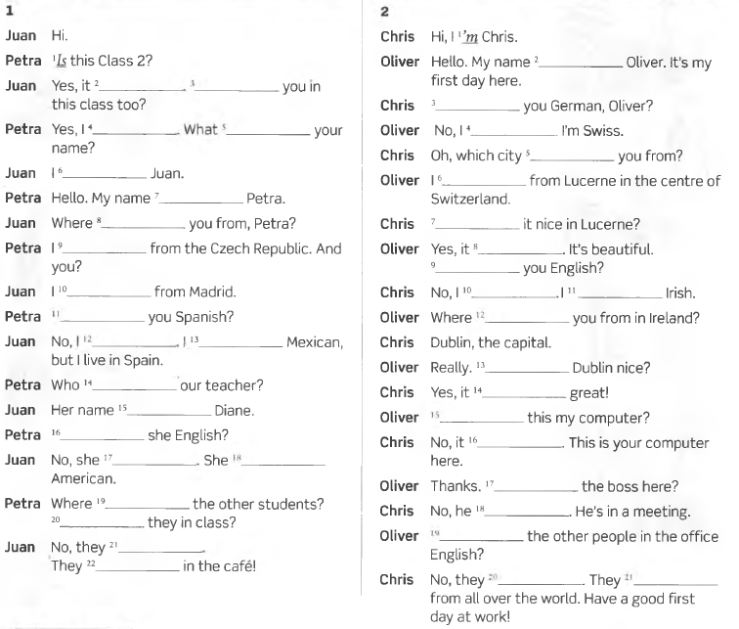

Slide 8
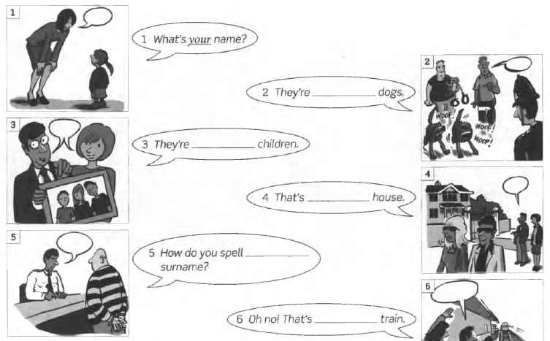
Look at the pictures. Complete the sentences with my,your, his, her, our, their.

Slide 9
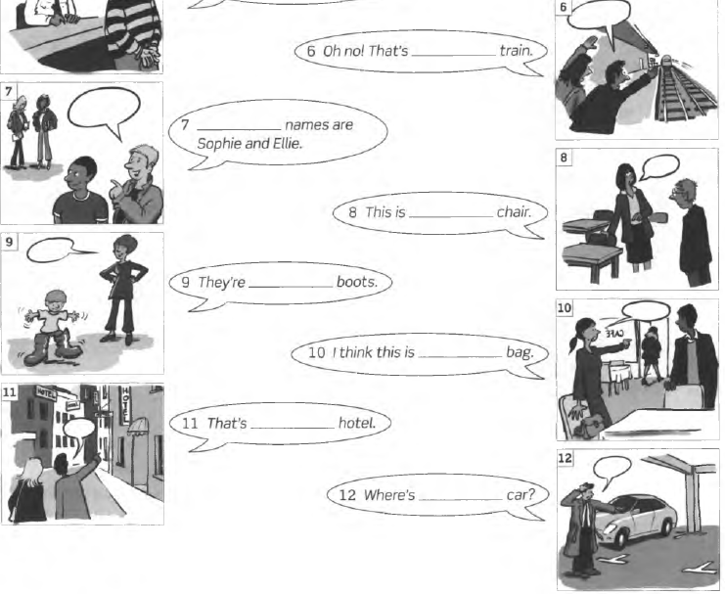

Slide 10
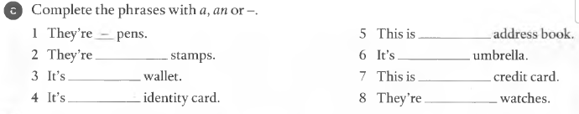
2А GRAMMAR a / an; plurals; this / that / these / those

Slide 11
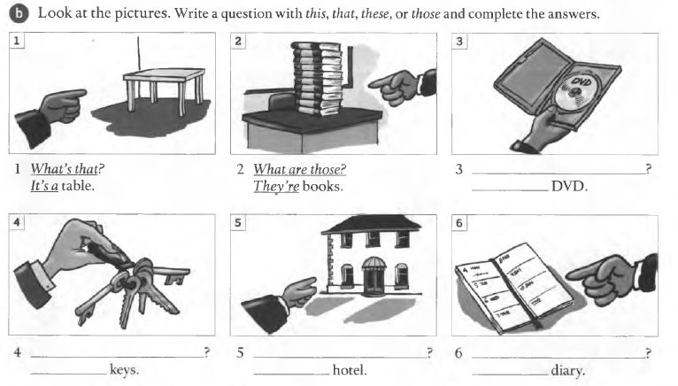

Slide 12
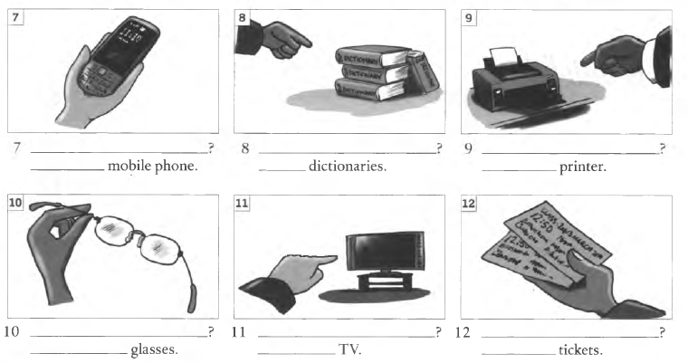

Slide 13


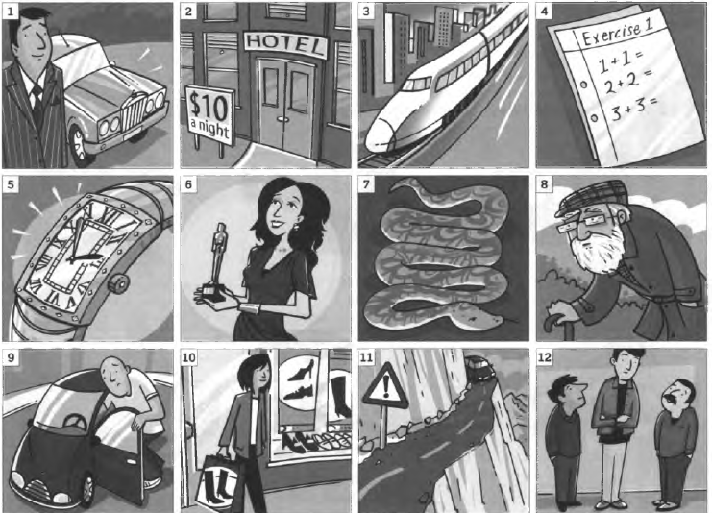

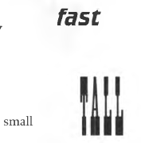
2B GRAMMAR adjectives

Slide 14
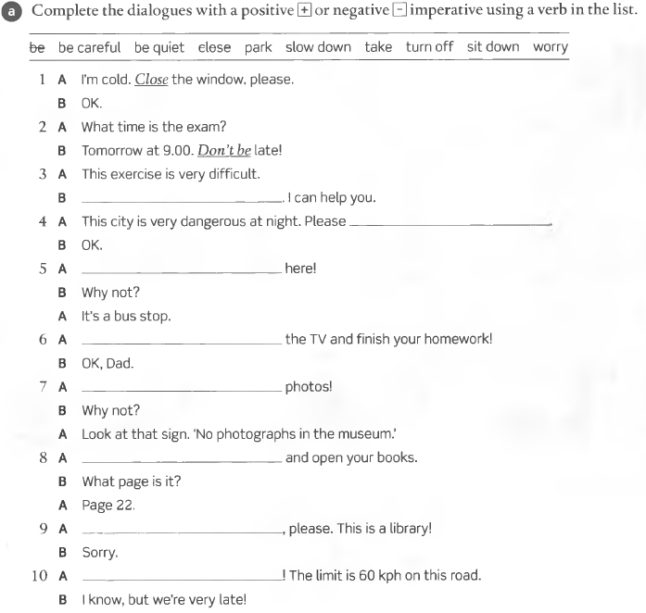
IMPERATIVES – LET’S

Slide 15
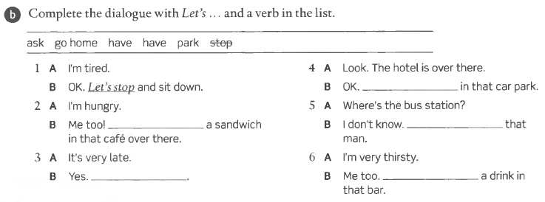
IMPERATIVES – LET’S

Slide 16
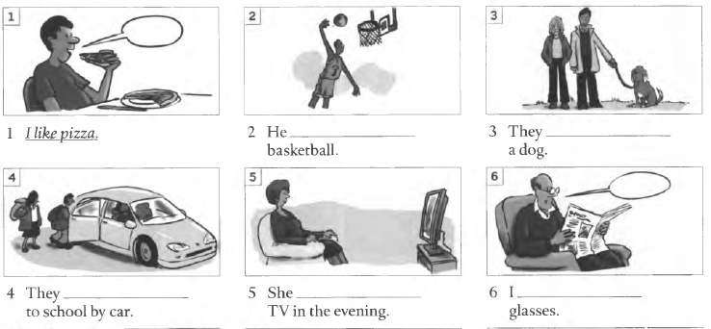
ЗА GRAMMAR present simple + and -

Slide 17
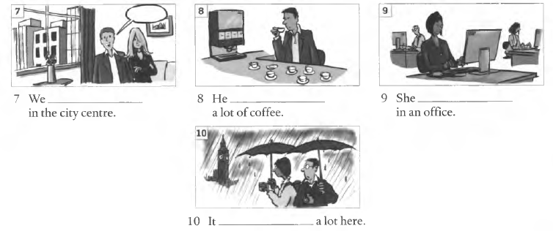
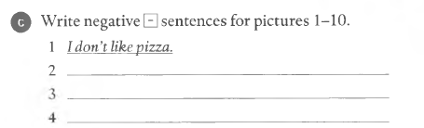

Slide 18
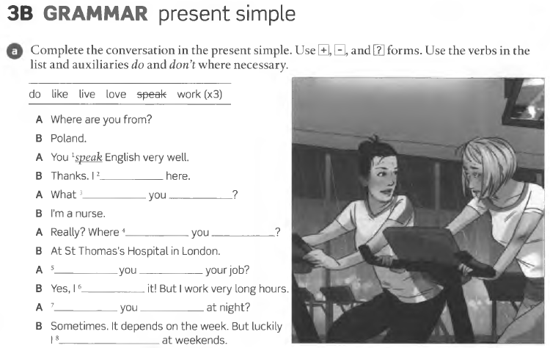

Slide 19
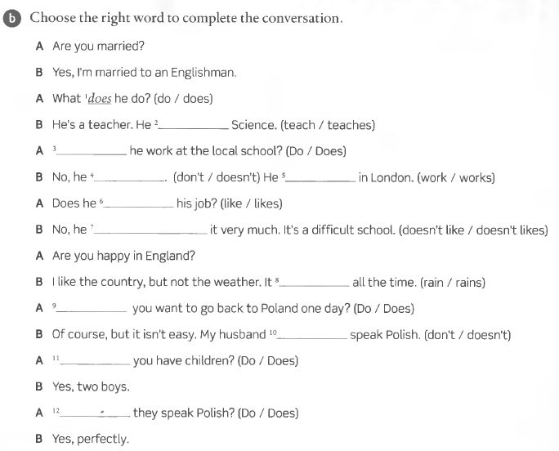
PRESENT SIMPLE

Slide 20
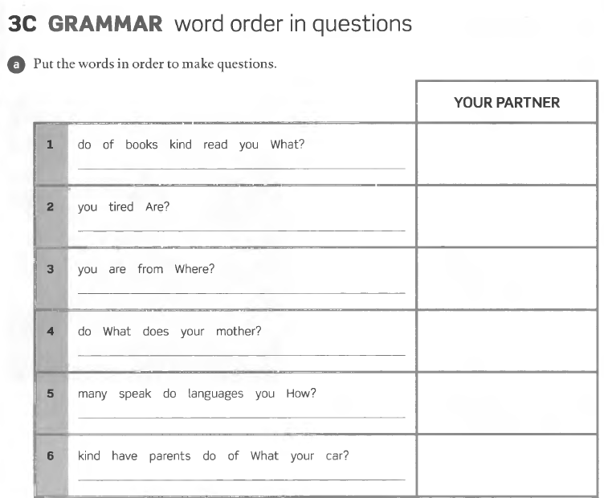

Slide 21
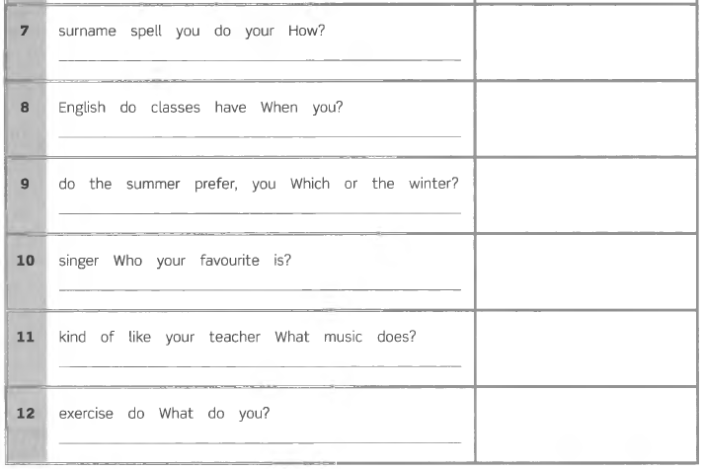

Slide 22
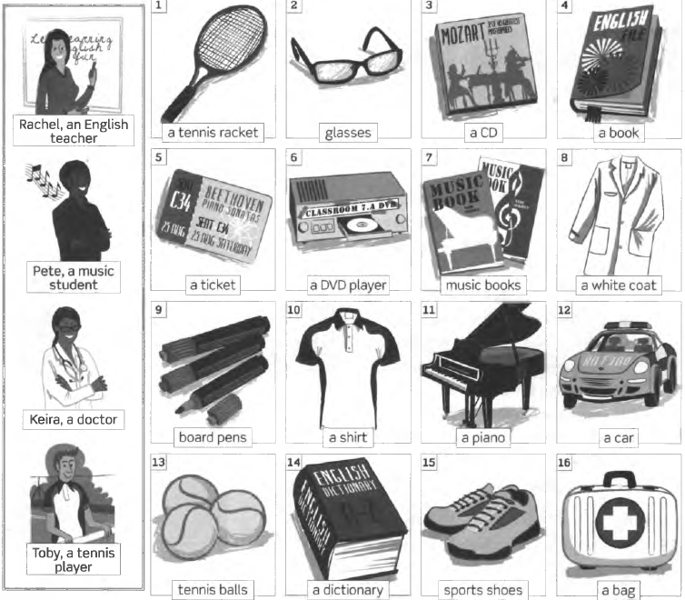
Whose are the objects?

Slide 23
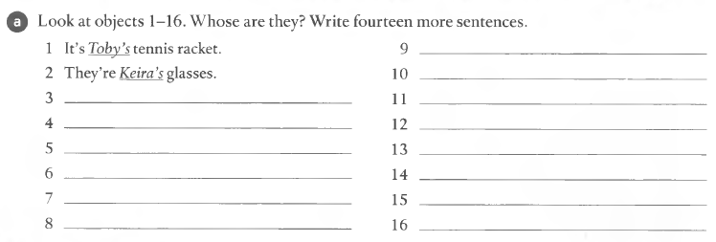
Whose are the objects?

Slide 24
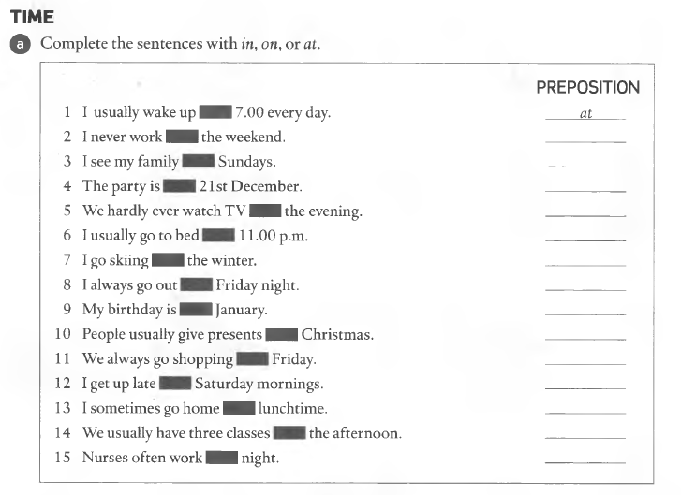
Prepositions of time

Slide 25
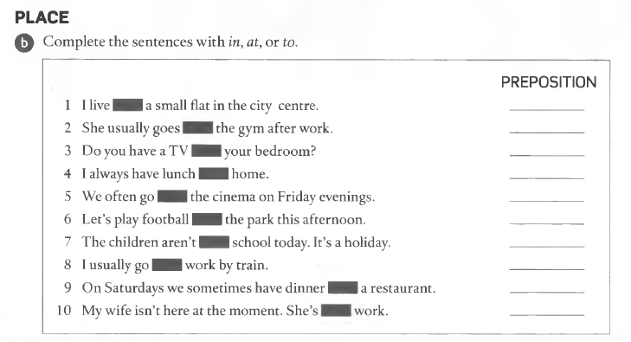
Prepositions of PLACE

Slide 26
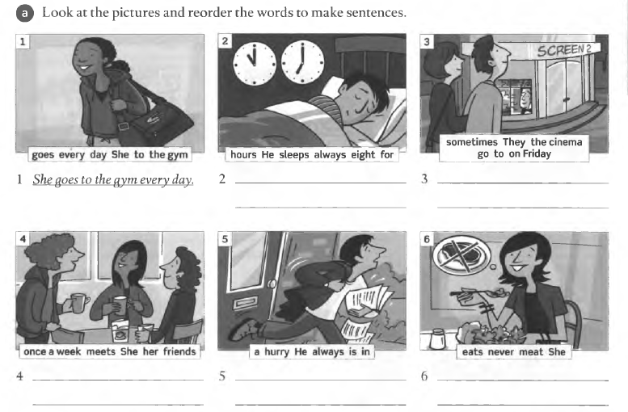
Adverbs and expressions of frequency

Slide 27
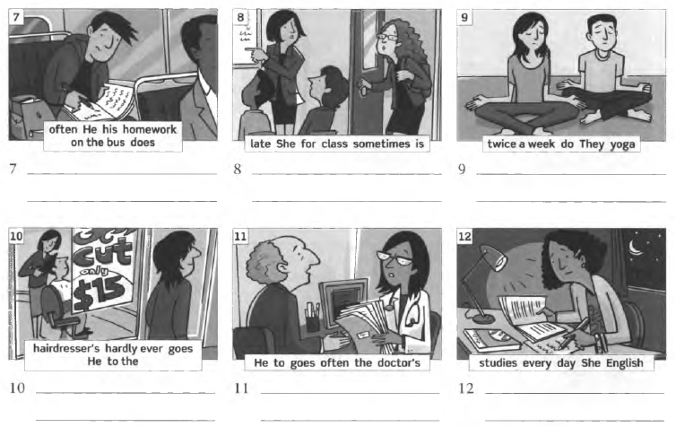
Adverbs and expressions of frequency

